Slide 1


High altitude environmental surveys above the Navajo Nation

Slide 2

Acknowledgments
Arizona/NASA Space Grant Program
For their generous funding
Michelle Coe for diligent coordination, logistics, and event planning
Arizona Near Space Research Group (ANSR)
For their valuable time, enduring commitment, encouragement, and expertise
Stephen Thomas and Tonya Thomas, Clayton Jacobs, Randy Peckenpaugh, Jack Crabtree, Vince and Kim Jenkins, Bob Thompson, Bob Shipton

Slide 3
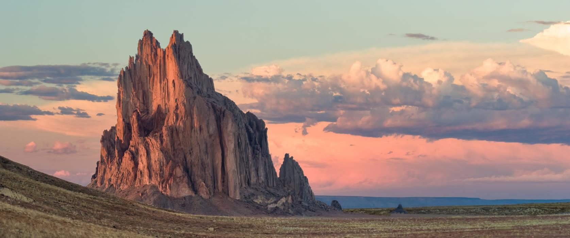
Diné (Navajo) Perspective
Air is a Gift of Life and must be treated with respect. “Air is the first thing we breathe when we enter this world and it will be the last thing we take as we leave this world.”

Slide 4
Educational philosophy at Diné College
Sa'ah Naagháí Bik'eh Hózóón: The Diné traditional living system that places Diné life in harmony with the natural world and the universe.

Slide 5
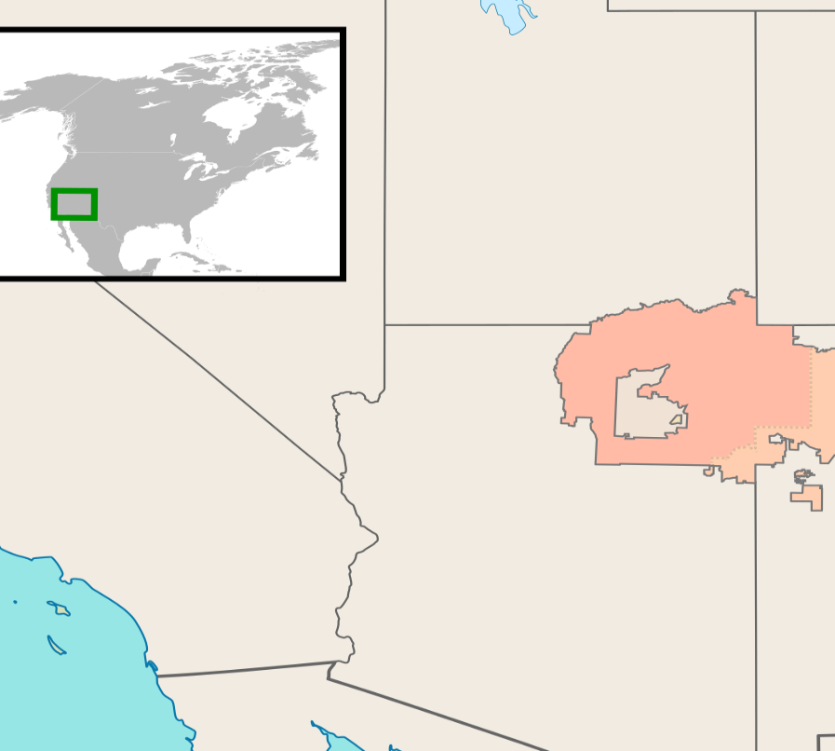
The Navajo Nation
1. Larger in area than 10 US States.
2. Yet has a smaller population (~350K) and lower median income (~27K) than all 50 states
3. Historically exploited, under-resourced, and mined (uranium, coal, natural gas, oil) leading to environmental and public health disasters.

Slide 6
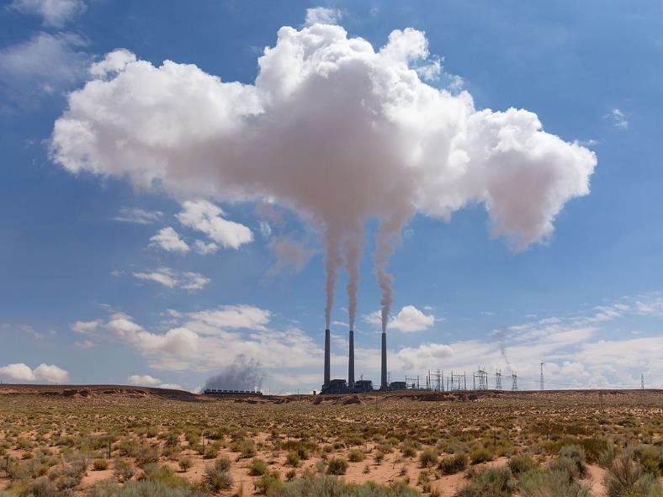
ASCEND! at Diné College
Proximate goal: With help from the Arizona Space Grant Consortium, empower our students to obtain high altitude environmental data on radiation, greenhouse gases (CO₂, CH₄), and atmospheric pollutants (NO₂, SO₂).
Ultimate goal: A marriage of Diné perspectives with data sovereignty. Empowerment of Diné people to obtain, analyze, manage, and share open access environmental datasets.

Slide 7

Investigation of Atmospheric UV and Ionizing Radiation
Lynshell Begay

Slide 8
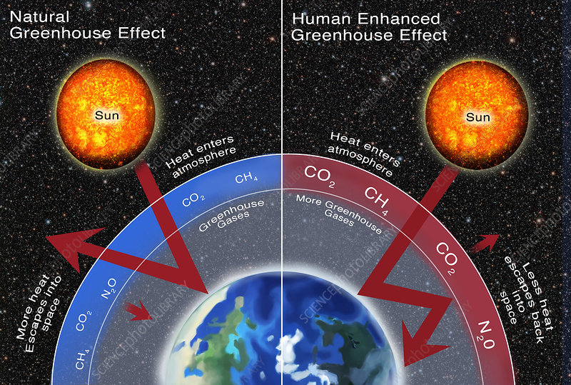
What is atmospheric radiation and why does it matter?
Health effects:
Short-term effects: Sunburn, aggravation of skin diseases.
Long-term effects: Skin cancer, photoageing

Slide 9
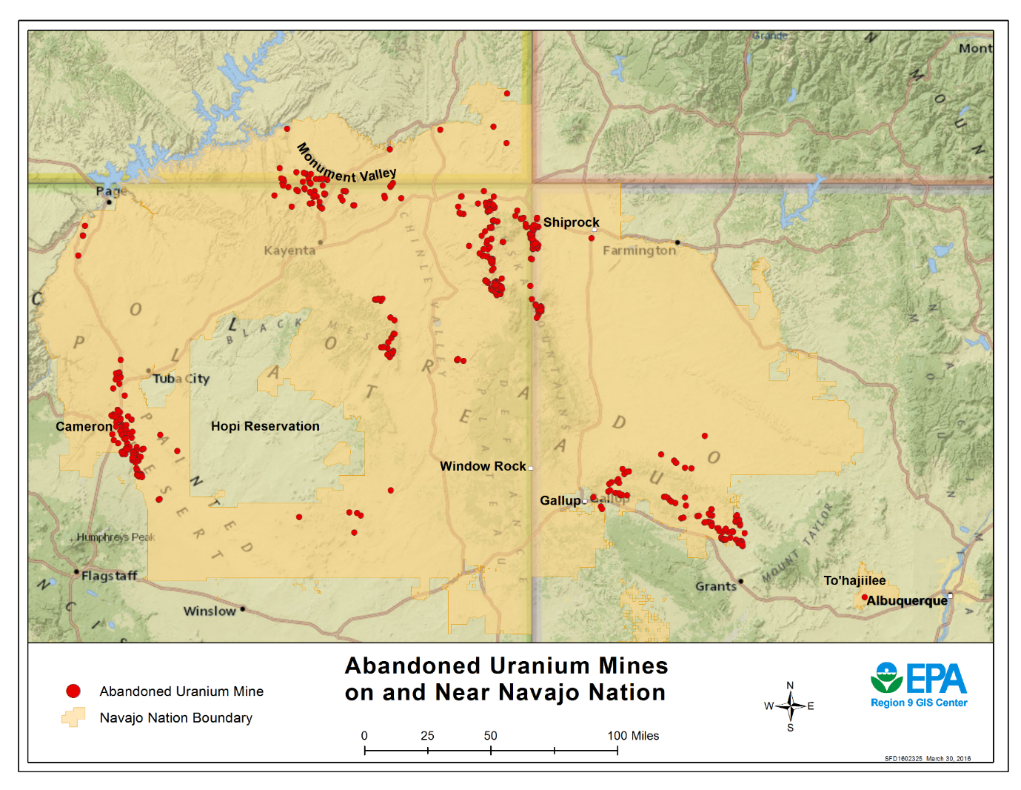
Ionizing radiation and why it matters
Uranium mining on the Navajo Nation
1944 – 1986

Slide 10
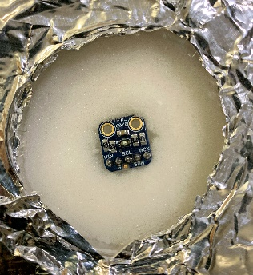
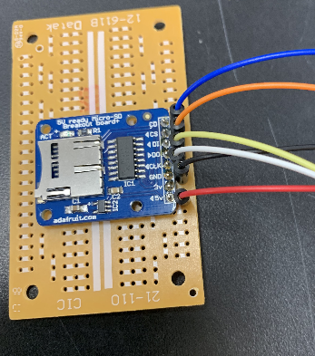
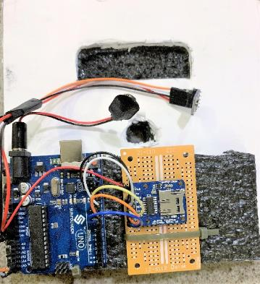
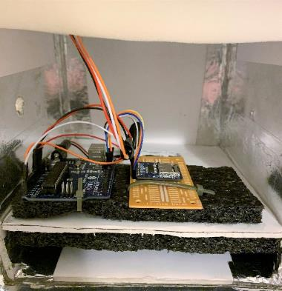
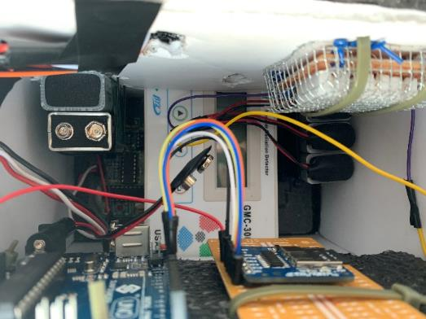
Construction of Payload
Arduino Software 1.8.9 (IDE)
UV Sensor and SD Breakout board required soldering
Sunfounder UNO R3 control board
Arduino sketches were uploaded to UNO R3
Verify code and solder wires and SD breakout board
Assemble and secure control board with components
into the payload box

Slide 11
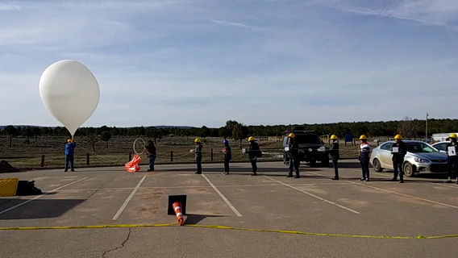
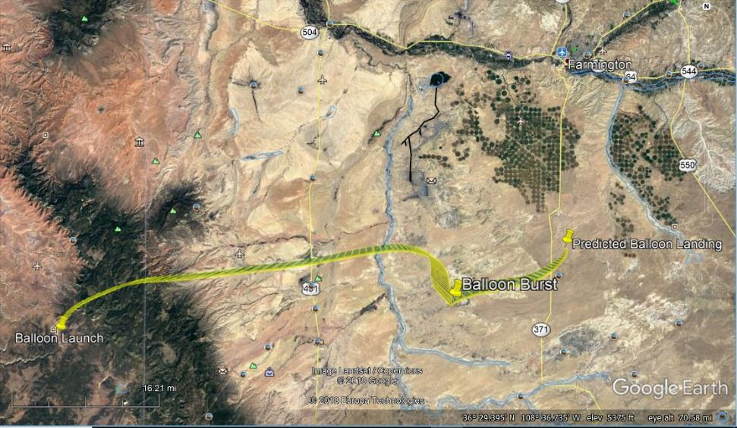
The Flight
Launch
Flight path
High Altitude balloon filled with Helium
Pops in the atmosphere around ~91,000 feet
Takeoff at Dine’ College in Tsaile, AZ

Slide 12
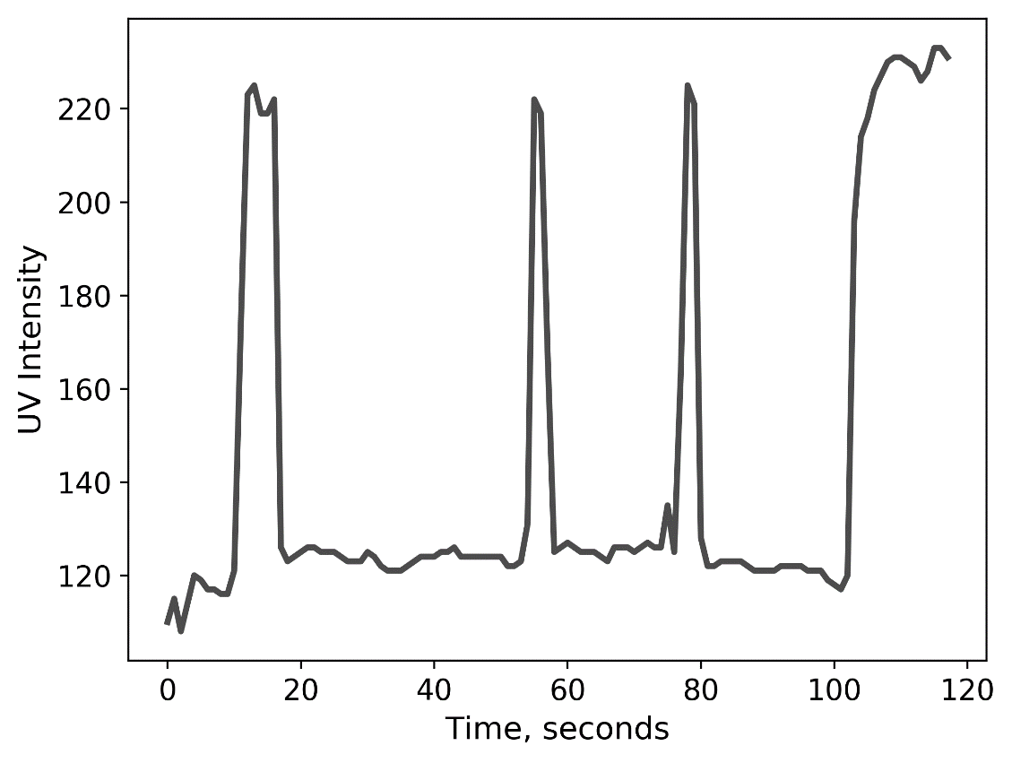
Results: UV sensing hardware collected little-to-no data
Worked well in testing:
UV sensitivity
Data logging
Potential causes of failure:
Temperature
Physical stress or collisions resulting in hardware shutdown.

Slide 13
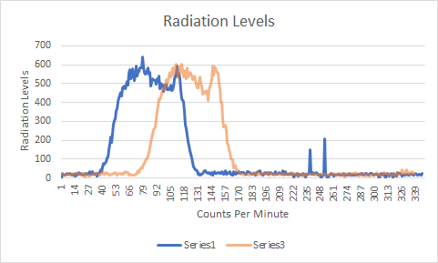
Results: Geiger counter collected no data
Worked well in 2018 and in testing
Potential causes of failure:
Physical stress or collision resulting in hardware shutdown.
From ASCEND 2018

Slide 14
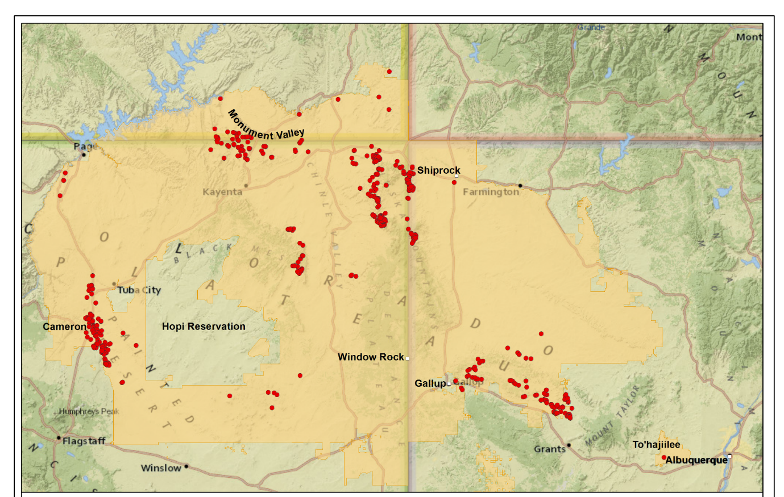
Both UV sensing hardware and Geiger counter collected little-to-no data
Paths forward:
Initiate ground-level monitoring post-symposium
Advise/assist 2020 ASCEND students

Slide 15
Nitrogen Dioxide(NO₂) on the Navajo Nation
Dennison John Jr.

Slide 16
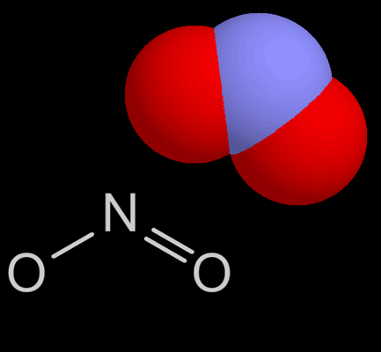
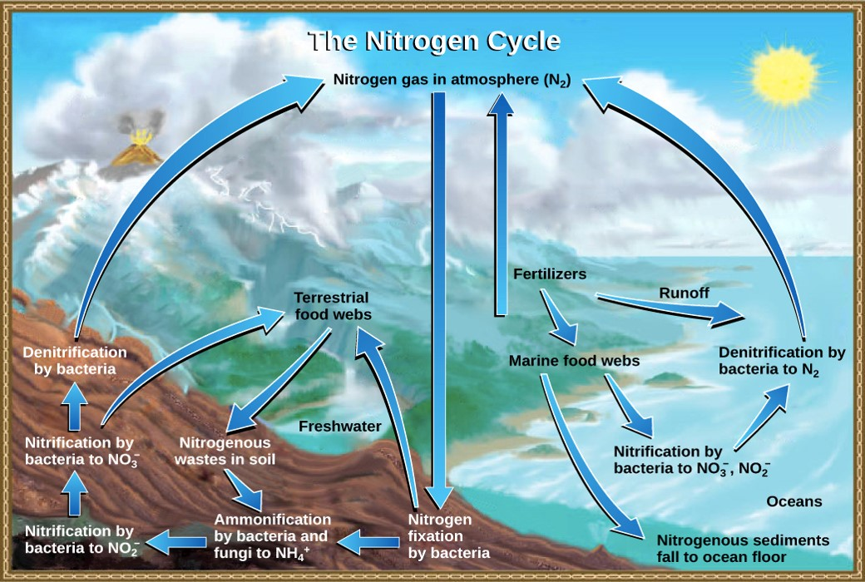
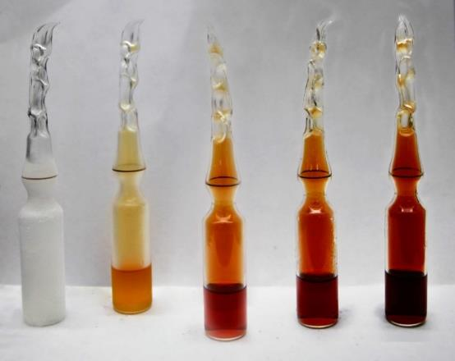
What is Nitrogen Dioxide?
Nitrogen Dioxide(NO₂): A naturally occurring gas. Part of the Nitrogen cycle. Volcano, fire, nitrification.
Notes:
Nitrogen Dioxide(NO₂) is a naturally occurring gas that all living animals partially breath. Through human intervention and emission of coal powered power plants, have contributed to the pollution. However presently, the concentration of NO2 has decreased over a span of years.

Slide 17
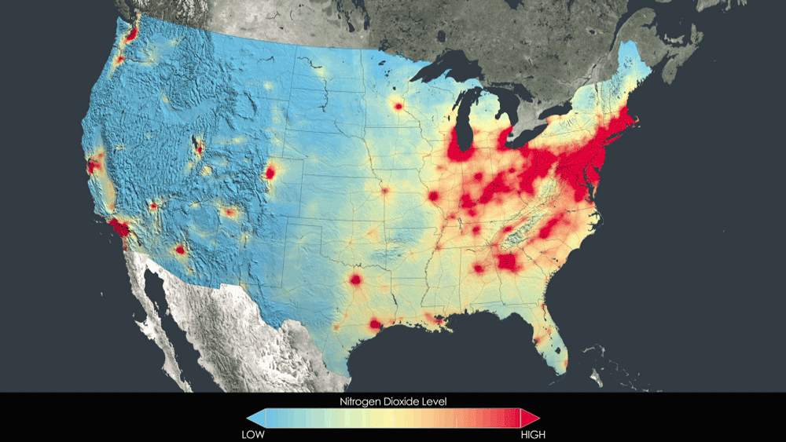

Sources of NO₂
Heavily concentrated in Eastern US. Patches of high concentration west of MS River.
Anthropogenic sources: Vehicles, farm equipment, and coal plants, and others.

Slide 18
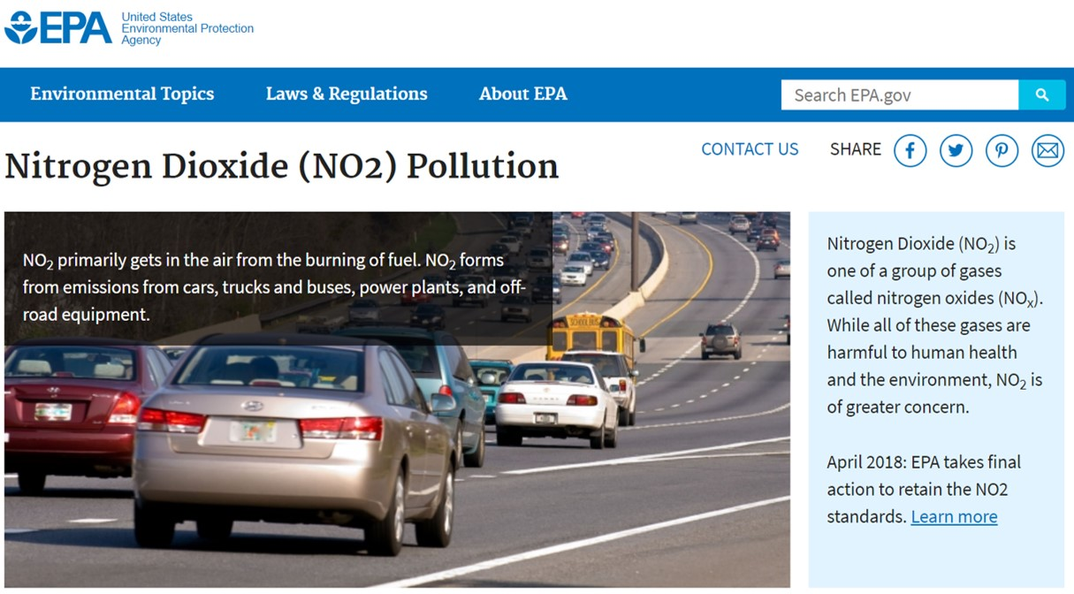
Why does it matter?
NO₂ diffuses into the epithelial lining fluid (ELF) of the respiratory epithelium and dissolves. It chemically reacts with molecules in the ELF.
Health effects:
When introduced into the respiratory tract, NO₂ drives bronchoconstriction, inflammation, reduced immune response, and may have effects on the heart.
Notes:
A gas that mostly comes from the burning of fossil fuels. Here in the Navajo Nation, coal powered plants are the main source of NO2.

Slide 19
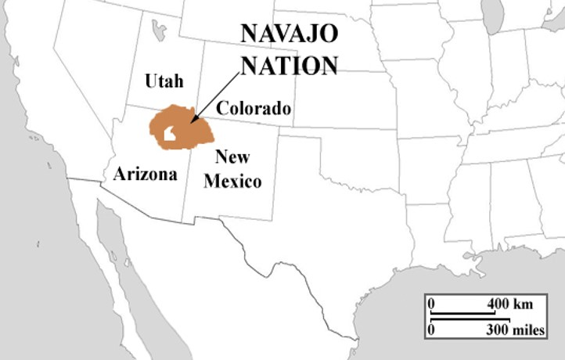
Study of NO₂ on the Navajo Nation
The Navajo Nation
Anthropogenic sources:
Large coal powered plants
major source of pollutants
Automobile or agricultural
perhaps minor influence
Individual home burning of coal
perhaps minor contribution to regional pollution
However: Little is known of the NO₂ concentrations on the Navajo Nation

Slide 20
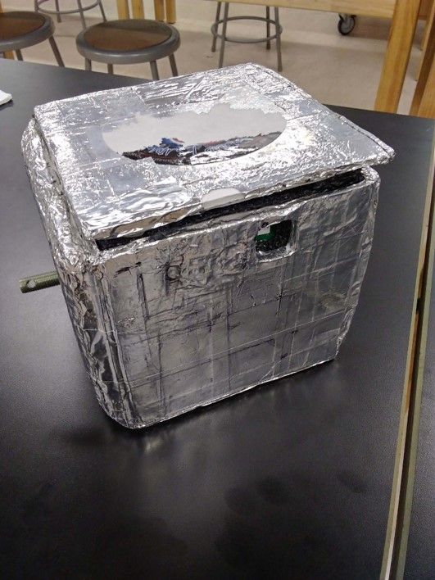
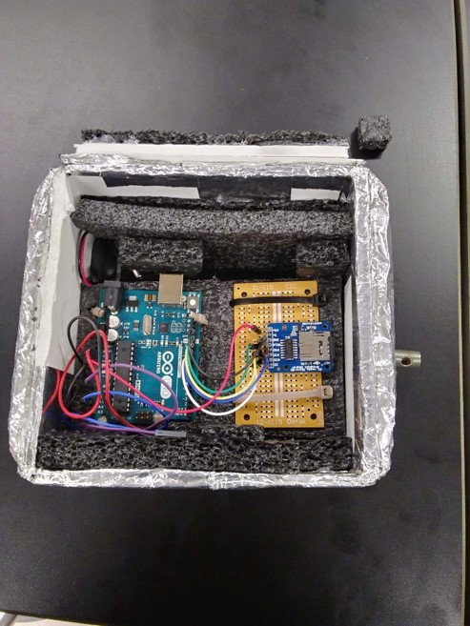
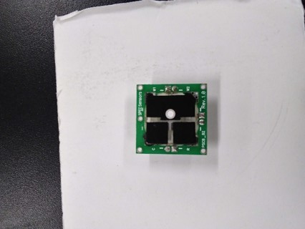
Construction of NO₂ payload
Components:
Arduino UNO microcontroller
Environmental SPEC sensor(NO₂)
Other payload components:
Battery
Heater

Slide 21
The Flight
Launch
Flight path
High Altitude balloon filled with Helium
Pops in the atmosphere around ~91,000 feet
Takeoff at Dine’ College in Tsaile, AZ

Slide 22
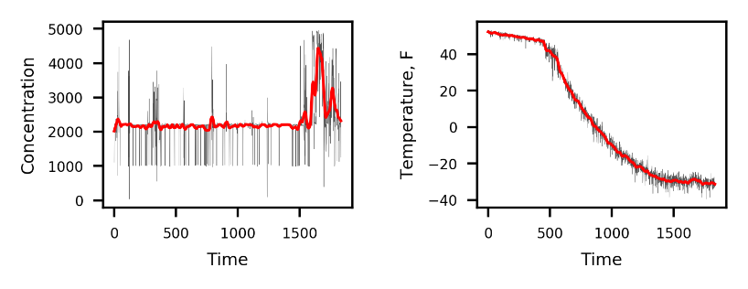
Results
Locally-weighted scatter smoothing reveals a major change in the overall concentration of NO₂ in the atmosphere towards the end of the ascent.
Change in temperature occurred as expected (values not calibrated).
Notes:
Needs to be transformed, were looking at the pattern of change in the last end as the temperature change
1ppm= 1,000 ppb
Calcu;ations are needed to understand more
The bounce around while being in attached to the balloon made the Arduino turn on and off

